Slide 1


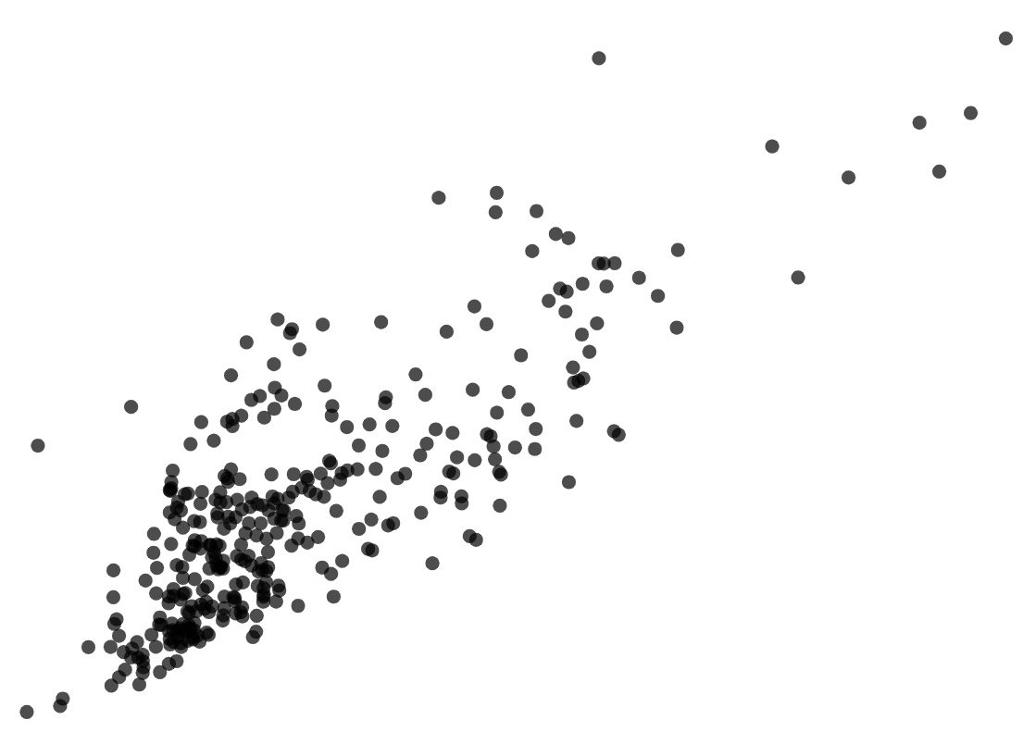
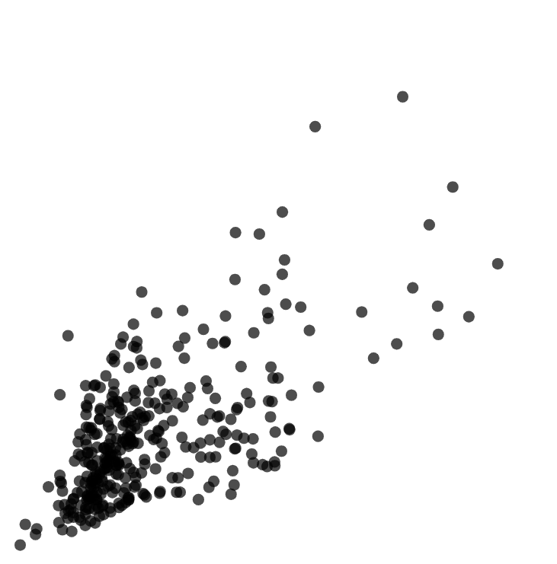
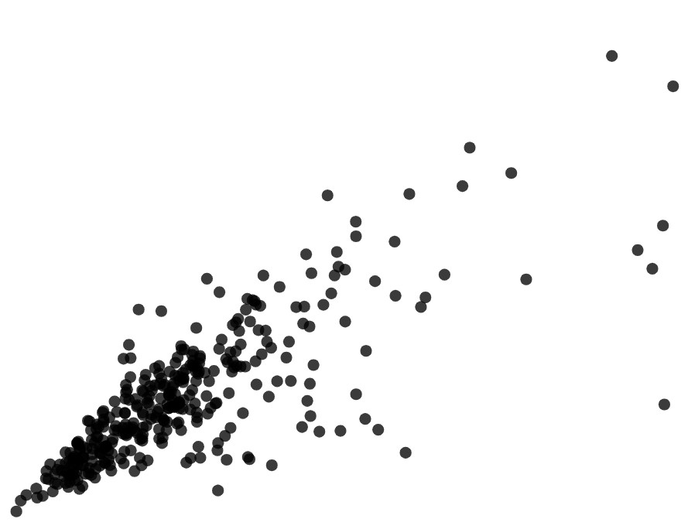
Correlation
Task A: Recognising correlation in bivariate data
1) Fully describe the correlation in each scatter graph.
a)
b)
positive correlation
negative correlation
2) For each set of bivariate data, tick whether you would expect the correlation to be positive or negative.
 | positive | negative
children’s heights and their shoe sizes
steepness of a hill and walking speed up the hill
3) The three scatter graphs show data from the Office for National Statistics. Each point represents a region in England and Wales in 2015.
cell phone towers
transport emissions
transport emissions
population
population
cell phone towers
Jacob thinks that the third scatter graph shows that cell phone towers cause more traffic pollution because there is a positive correlation.
Explain why Jacob could be wrong.
Correlation does not always mean that one variable is affecting the other.
Correlation may suggest there is an association between the variables, not necessarily a cause and effect relationship.
The number of cell phone towers and the amount of traffic emissions could both be affected the population of the region.

Slide 2
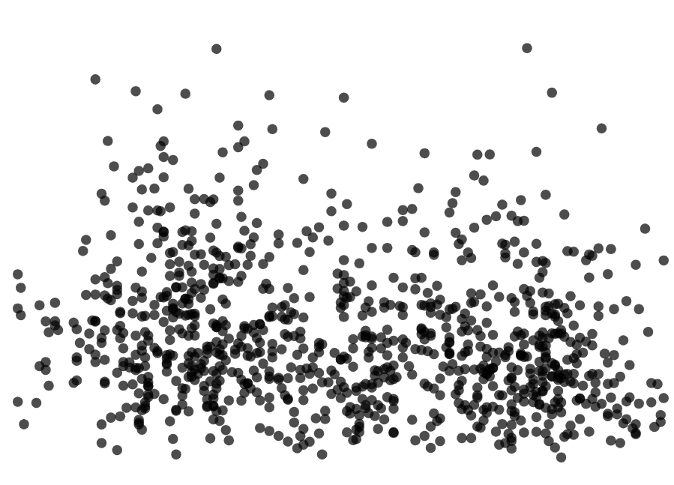
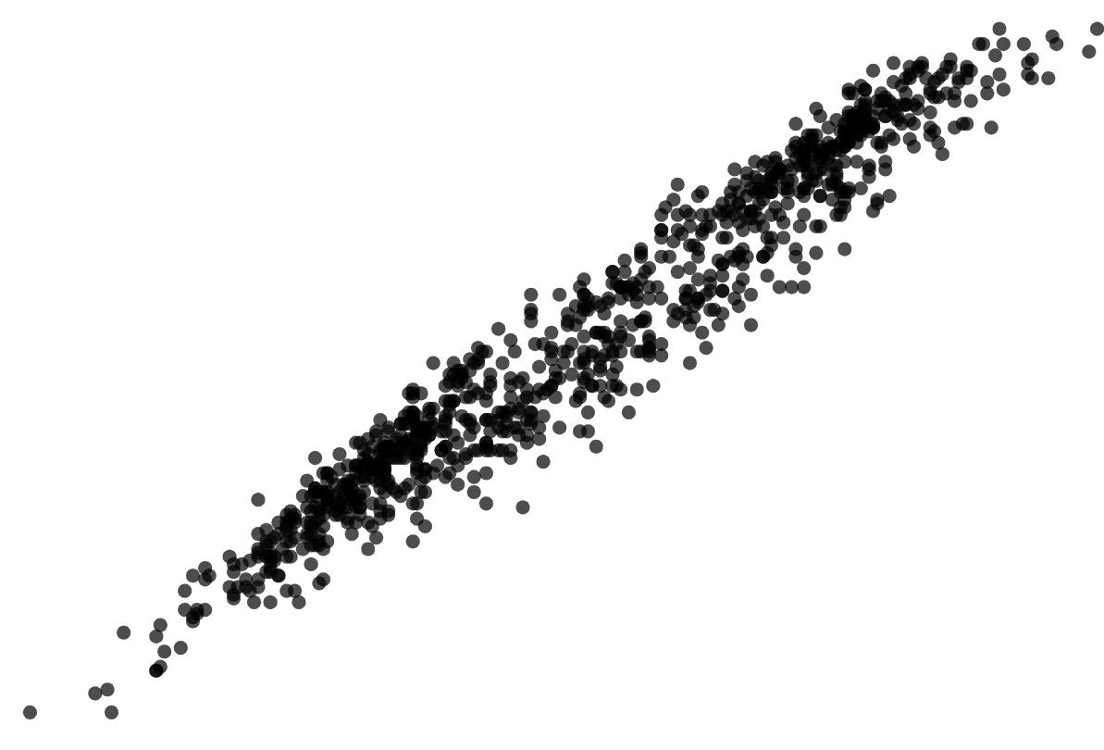
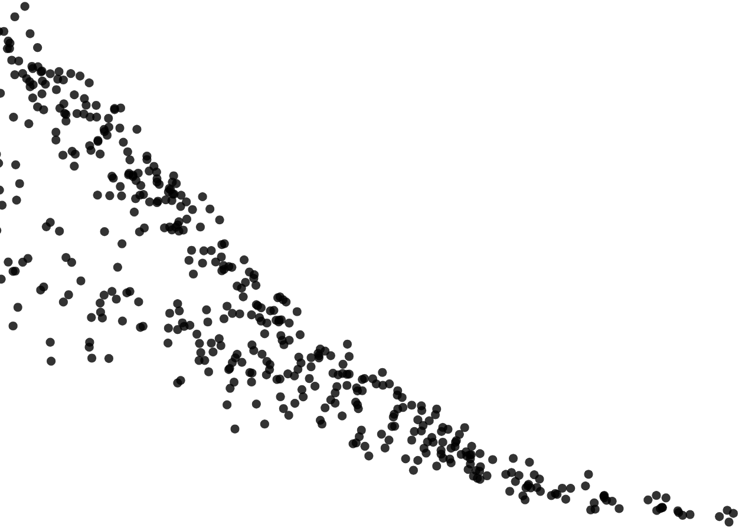
Correlation
Task B: Interpreting bivariate data without correlation
1) Here are four scatter graphs.
Graph 1
Graph 2
Graph 3
Graph 4
Graph 2
a) Which graph shows a positive correlation?
Graph 3
b) Which graph shows a negative correlation?
Graph 4
c) Which graph shows an association which is not linear?
d) Which graph shows no association?
Graph 1
Mathematics in Education and Industry
v2.2

